Slide 1
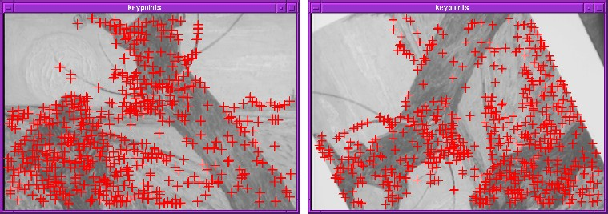
Harris角点：如何提取特征点
Key property: in the region around a corner, image gradient has two or more dominant directions
Corners are repeatable and distinctive
C.Harris and M.Stephens. "A Combined Corner and Edge Detector.“
Proceedings of the 4th Alvey Vision Conference: pages 147—151, 1988.

Slide 2











简单思路
We should easily recognize the point by looking through a small window
Shifting a window in any direction should give a large change in intensity
“flat” region: no change in all directions
“edge”:
no change along the edge direction
“corner”: significant change in all directions

Slide 3
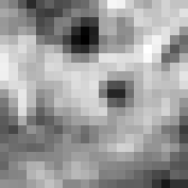


Corner Detection: MATHEMATICS
Change in appearance of window w(x,y) for the shift [u,v]:
E(u, v) = ∑ w(x, y)[I (x + u, y + v) − I (x, y)]²
x, y
I(x, y)
E(u, v)
E(3,2)
w(x, y)

Slide 4
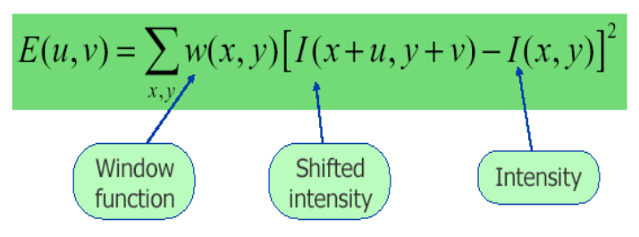
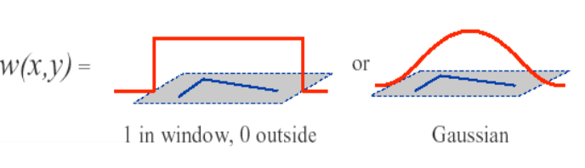
Harris角点算子
其中w是窗函数，它可以是加权函数，也可以是高斯函数
Notes:
移动大的地方权值小，因为本身就容易造成大的响应

Slide 5
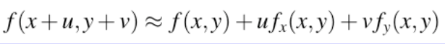
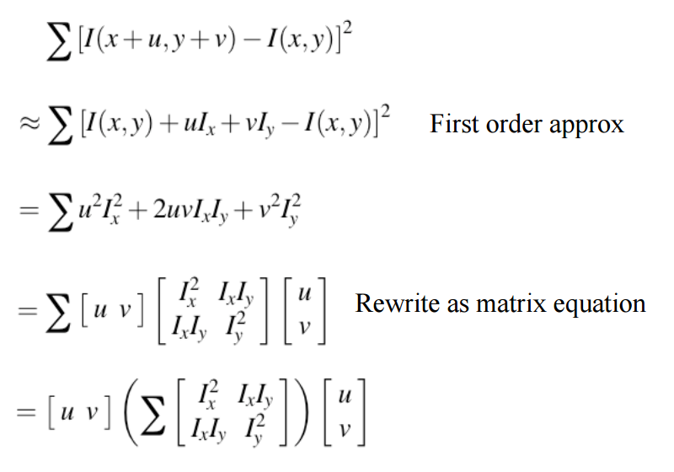
Harris角点算子
Taylor展开

Slide 6
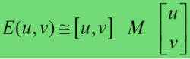
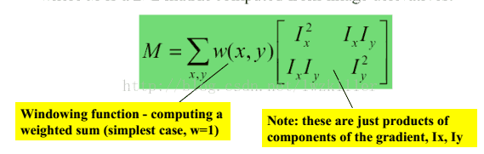
Harris角点算子

Slide 7
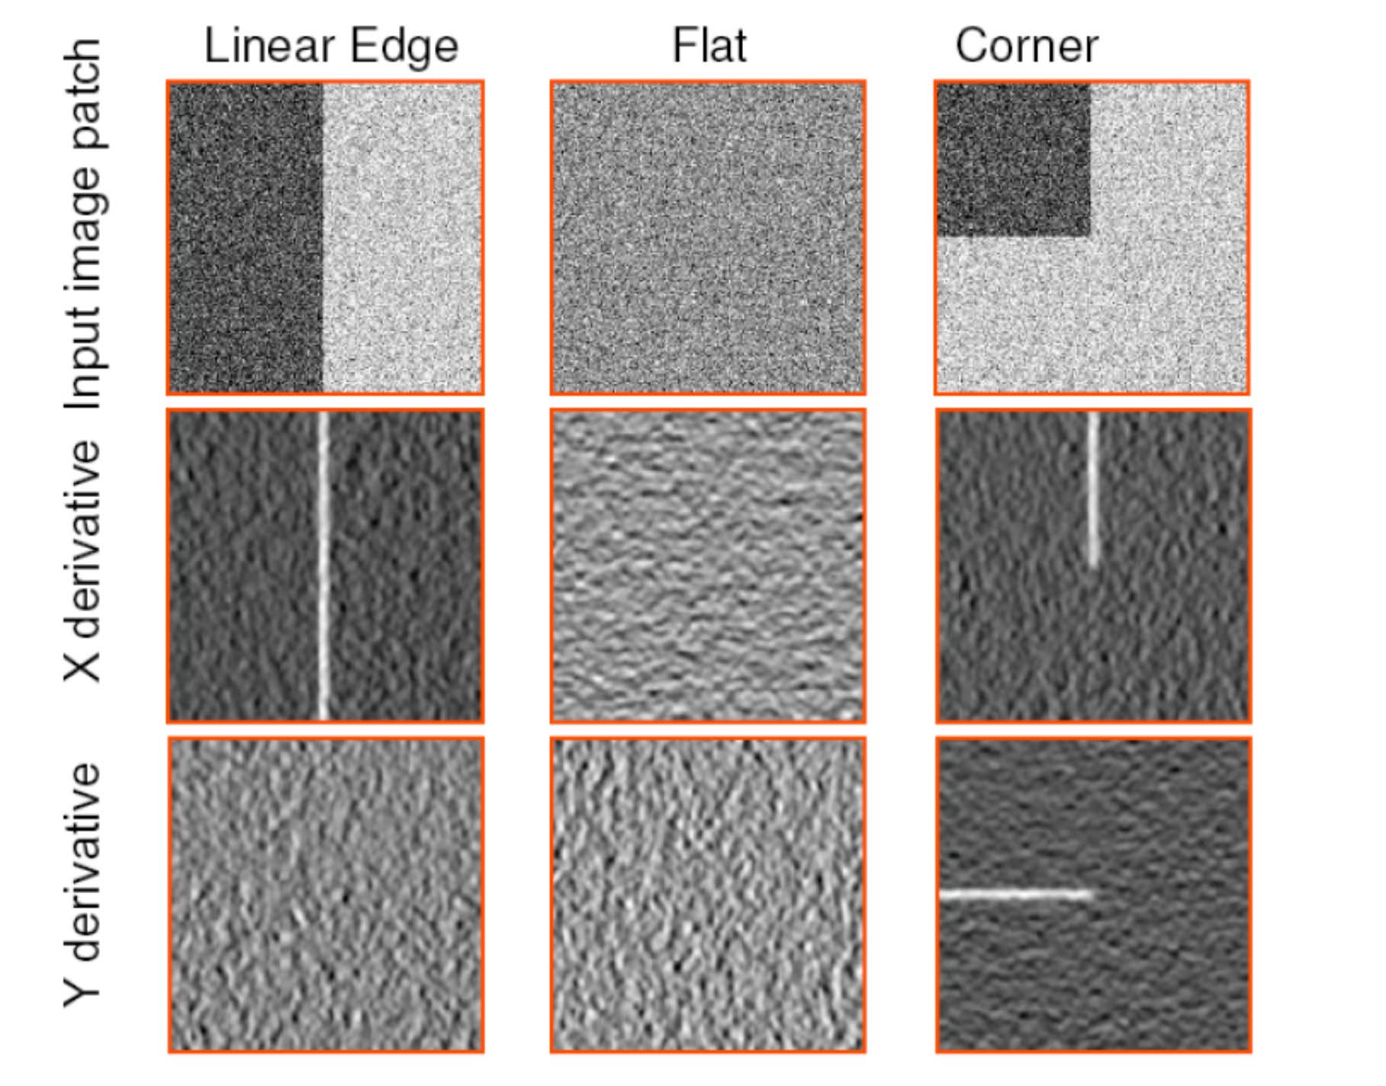

Slide 8
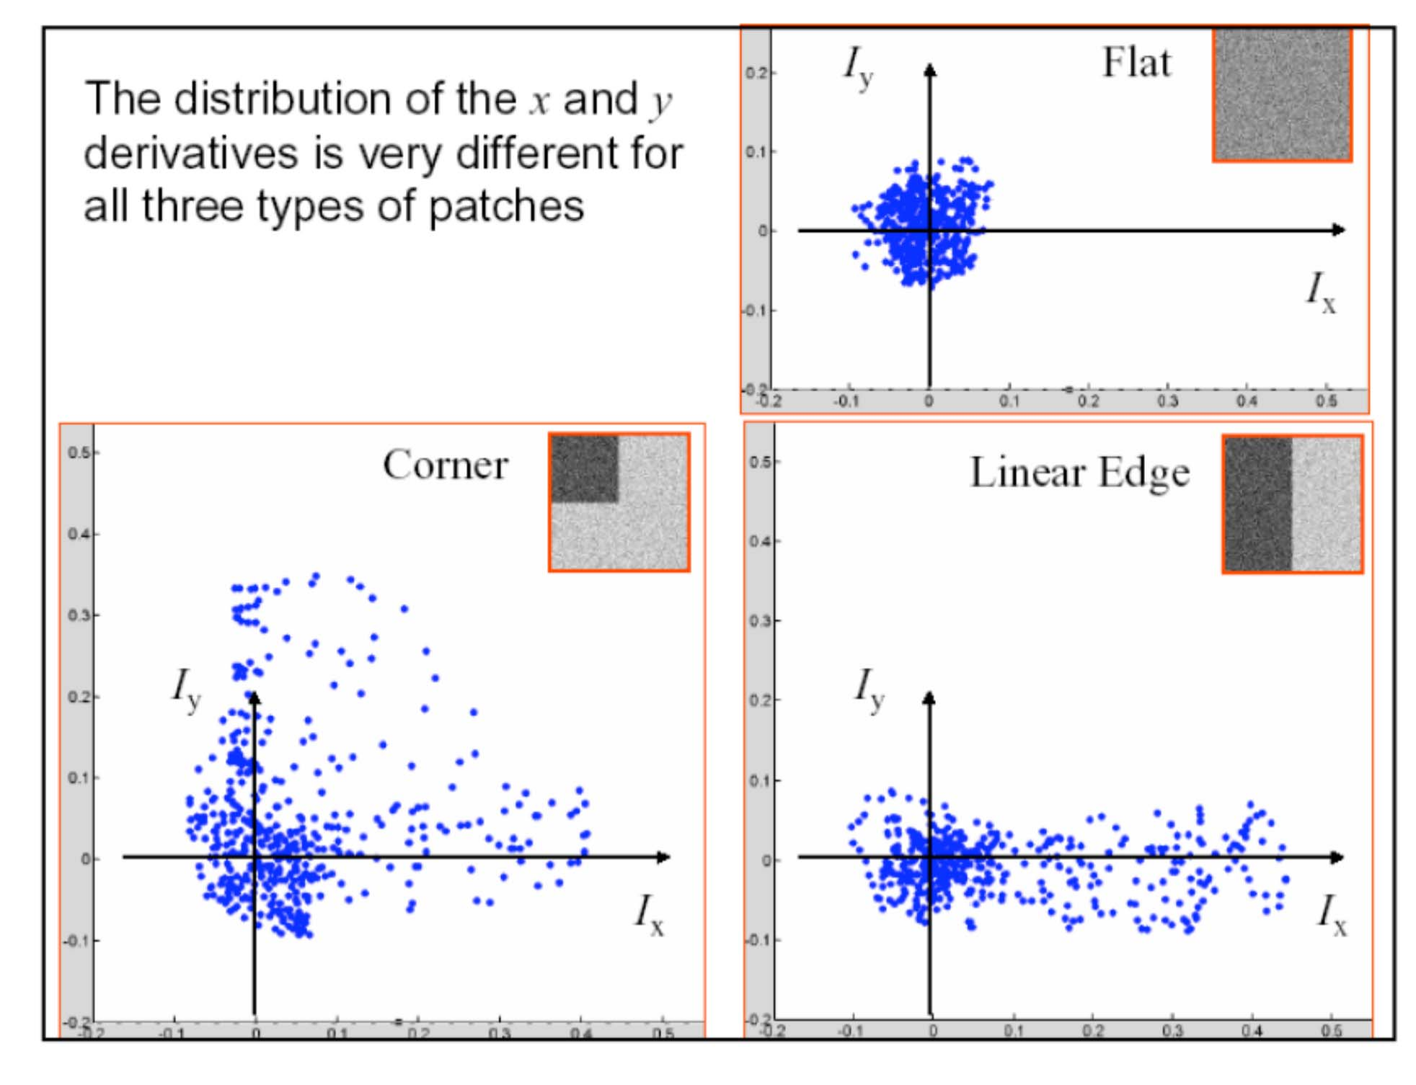

Slide 9
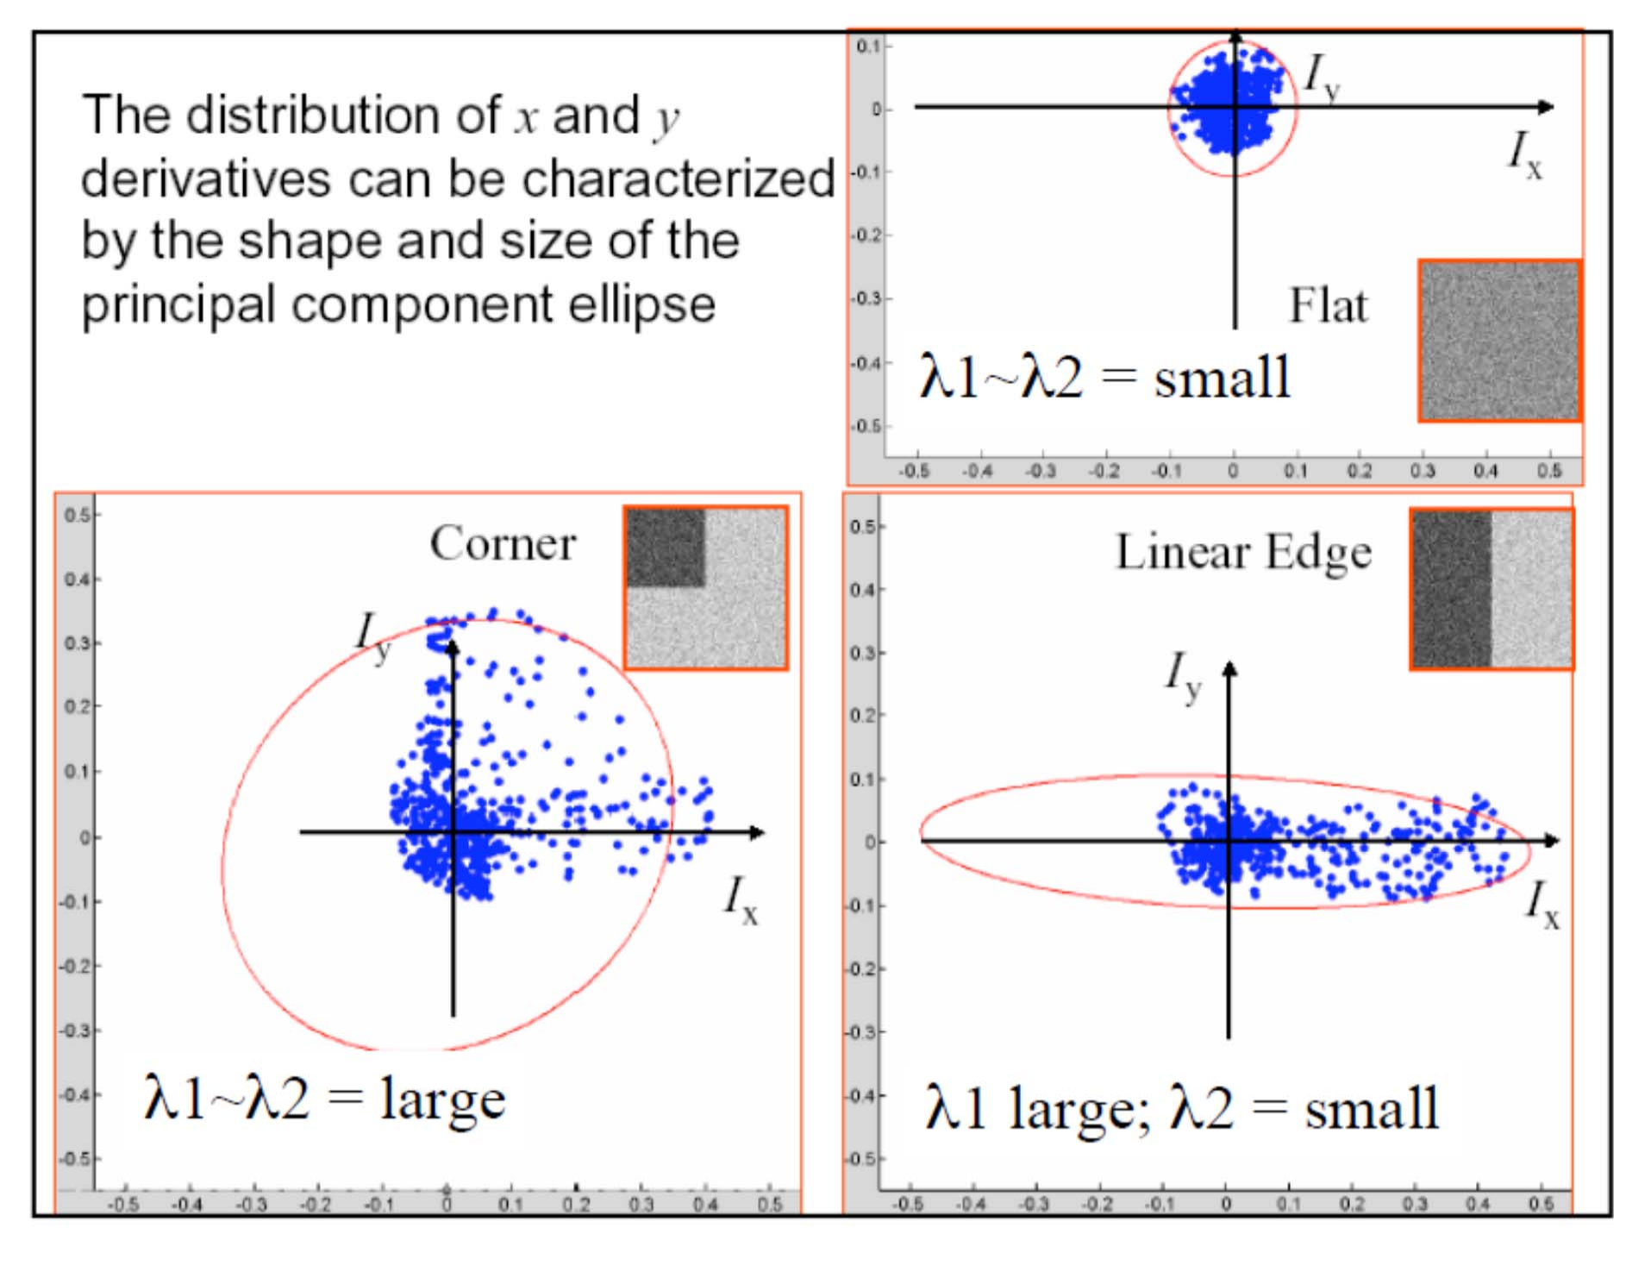

Slide 10

矩阵特征值的解释
Classification of image points using eigenvalues of M:
λ₂
“Edge”
λ₂ >> λ₁
“Corner”
λ₁ and λ₂ are large,
λ₁ ~ λ₂;
E increases in all directions
λ₁ and λ₂ are small; E is almost constant in all directions
“Flat” region
“Edge”
λ₁ >> λ₂
λ₁

Slide 11
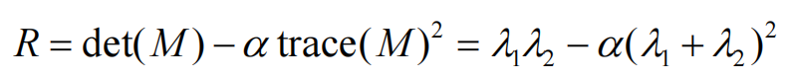
角点响应方程
α: constant (0.04 to 0.06)
“Edge” R< 0
“Corner” R > 0
|R| small
“Flat” region
“Edge” R < 0

Slide 12
HARRIS 角点检测器
Compute Gaussian derivatives at each pixel
Compute second moment matrix M in a Gaussian window around each pixel
Compute corner response function R
Threshold R
Find local maxima of response function (nonmaximum suppression)
C.Harris and M.Stephens. “A Combined Corner and Edge Detector.”
Proceedings of the 4th Alvey Vision Conference: pages 147—151, 1988.

Slide 13
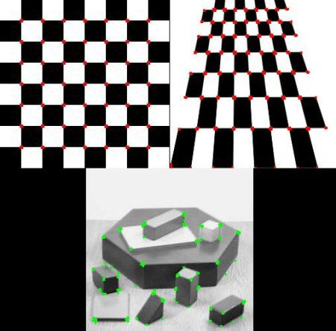
Harris角点算子

Slide 14
Harris角点算子
哈里斯角点的性质：
该算法算子对亮度和对比度的变化不敏感
算子具有旋转不变性
算子不具有尺度不变性

Slide 15

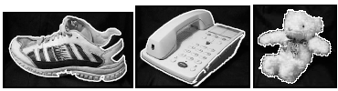
SIFT算子的应用

Slide 16
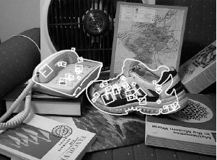

SIFT算子的应用

Slide 17
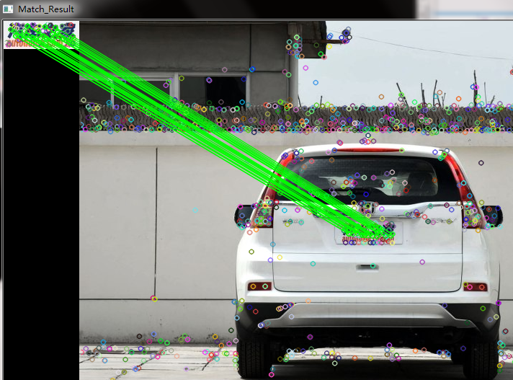
SIFT算子的应用

Slide 18
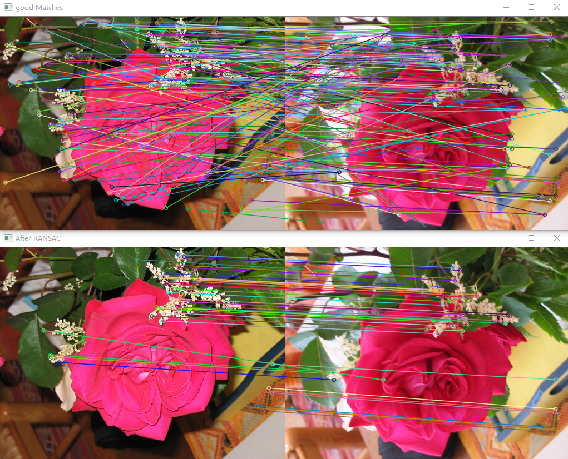
SIFT算子的应用
SIFT特征提取+RANSAC剔除误匹配点

Slide 19
图像对准拼接

Slide 20


基于特征的图像对准的过程
提取特征
特征匹配

Slide 21
基于特征的图像对准的过程
提取特征
特征匹配
迭代:
选择三个特征点对，得到初始变换T

Slide 22
基于特征的图像对准的过程
提取特征
特征匹配
迭代:
选择三个特征点对，得到初始变换T
利用其它特征点对，验证变换T

Slide 23

基于特征的图像对准的过程
提取特征
特征匹配
迭代:
选择三个特征点对，得到初始变换T
利用其它特征点对，验证变换T

Slide 24
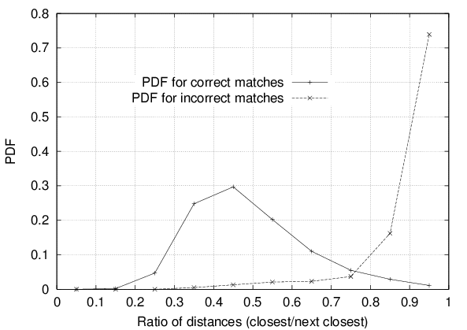
特征空间噪声点的排除
怎样判断哪些特征点对是可靠的？
启发式: 比较特征空间内最近邻的距离和次近邻的距离
对于那些不太明确的特征对而言，最近邻的距离和次近邻的距离的比值通常会比较大
Threshold of 0.8 provides good separation
David G. Lowe. "Distinctive image features from scale-invariant keypoints.” IJCV 60 (2), pp. 91-110, 2004.

Slide 25
特征匹配
采用关键点特征向量的欧式距离来作为两幅图像中关键点的相似性判定度量。
取图像1中的某个关键点，并找出其与图像2中欧式距离最近的前两个关键点，在这两个关键点中，如果最近的距离除以次近的距离少于某个比例阈值，则接受这一对匹配点。降低这个比例阈值，SIFT匹配点数目会减少，但更加稳定。

Slide 26
噪声点排除：RANSAC
RANdom Sample Consensus
随机样本一致性检验
动机：如果点对选择正确，得到的变换矩阵对其他很多点都适用

Slide 27
RANSAC
Approach: we want to avoid the impact of outliers, so let’s look for “inliers”, and use those only.
Intuition: if an outlier is chosen to compute the current fit, then the resulting line won’t have much support from rest of the points. （如果选到的点组成的）

Slide 28
RANSAC: 一般步骤
RANSAC loop:
Randomly select a seed group of s points on which to base model estimate
Fit model to these s points
Find inliers to this model (i.e., points whose distance from the line is less than t)
If there are d or more inliers, re-compute estimate of model on all of the inliers
Repeat N times
Keep the model with the largest number of inliers

Slide 29
RANSAC
(RANdom SAmple Consensus) :
Fischler & Bolles in ‘81.
Line fitting example
Algorithm:
Sample (randomly) the number of points required to fit the model
Solve for model parameters using samples
Score by the fraction of inliers within a preset threshold of the model
Repeat 1-3 until the best model is found with high confidence

Slide 30
RANSAC
(RANdom SAmple Consensus) :
Fischler & Bolles in ‘81.
Line fitting example
Algorithm:
Sample (randomly) the number of points required to fit the model (#=2)
Solve for model parameters using samples
Score by the fraction of inliers within a preset threshold of the model
Repeat 1-3 until the best model is found with high confidence

Slide 31
RANSAC
(RANdom SAmple Consensus) :
Fischler & Bolles in ‘81.
Line fitting example
Algorithm:
Sample (randomly) the number of points required to fit the model (#=2)
Solve for model parameters using samples
Score by the fraction of inliers within a preset threshold of the model
Repeat 1-3 until the best model is found with high confidence

Slide 32
RANSAC
δ
N_{I} = 6
Algorithm:
Sample (randomly) the number of points required to fit the model (#=2)
Solve for model parameters using samples
Score by the fraction of inliers within a preset threshold of the model
Repeat 1-3 until the best model is found with high confidence

Slide 33
RANSAC
δ
N_{I} = 14
Algorithm:
Sample (randomly) the number of points required to fit the model (#=2)
Solve for model parameters using samples
Score by the fraction of inliers within a preset threshold of the model
Repeat 1-3 until the best model is found with high confidence

Slide 34
Ex6: 特征点提取和匹配

